Slide 1
Project Presentation of Industry Oriented Hands on Experience (22CS422)
On
AI DRIVEN SMART HEALTH ADVISOR
Rahul Arora, Raghav, Hanish Mittal
2210992127,2210992114,2210991604
Supervised By
Dr. Shikha Tuteja
Department of Computer Science and Engineering,
Chitkara University, Punjab

Slide 2
Introduction
INTRODUCTION TO PREVENTIVE CARE
The Goal: Shift healthcare from reactive "sick care" to proactive "preventive care.“
Target Audience: Isolated, resource-limited, and underserved populations.
The Solution: A lightweight system combining the Internet of Medical Things (IoMT) with AI.
Core Function: Provides 24/7 personalized health advice using real-time vitals and authoritative medical guidelines.
2

Slide 3
Problem Statement
THE HEALTHCARE GAP
Delayed Triage: Patients seek help only when symptoms become critical, overburdening hospitals.
Resource Scarcity: Lack of immediate physician access and diagnostic centers in remote areas.
Medical Misinformation: Unverified social media advice spreads rapidly during epidemics (e.g., Nipah, COVID-19).
Infrastructure Limits: Existing AI health tools require heavy cloud computing and stable broadband, failing in rural settings.

Slide 4
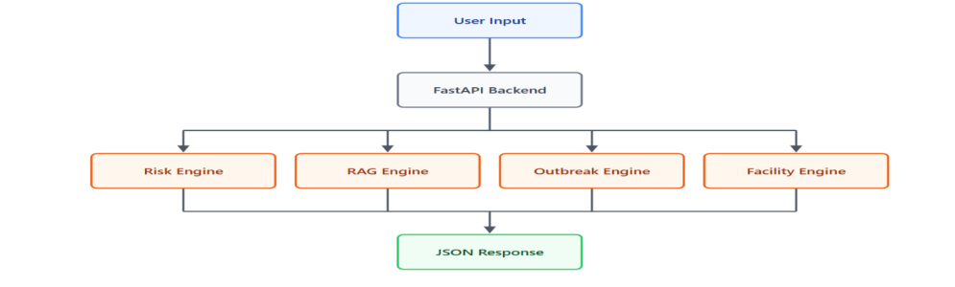
Technical Details (Architecture)
SYSTEM ARCHITECTURE
Frontend: React-based lightweight web interface optimized for low-end devices.
Orchestration: Express.js routing server acting as the API gateway.
Microservices Approach: Decoupled backend to ensure deployment flexibility.
FIG 1 – SYSTEM ARCHITECTURE

Slide 5
Technical Details (The Dual-Engine)
THE DUAL-ENGINE INFERENCE MODEL
1. Predictive Health Engine (Python/FastAPI):
Processes numerical vitals (Blood Pressure, Fasting Glucose).
Uses deterministic mathematical thresholds for explainable, low-compute risk classification.
2. Regulatory Inquiry Engine (Node.js/LangChain):
Uses Natural Language Processing (NLP) to analyze patient symptoms.
Executes a Retrieval-Augmented Generation (RAG) pipeline to fetch exact WHO/NCDC protocols.

Slide 6
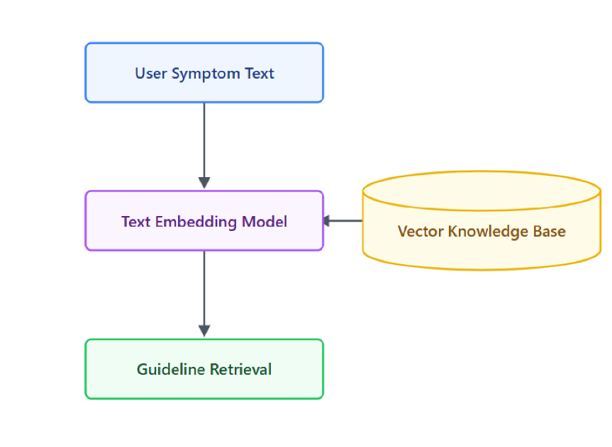
FIG 2 - RAG PIPELINE ARCHITECTURE MODEL

Slide 7
KEY FEATURES
Outbreak-Aware Triage: Maps symptoms directly to active epidemics (e.g., Dengue, COVID-19) based on region.
Clear Actionable Advice: Categorizes risk into visual tiers (Home Care vs. Immediate Emergency).
Hardware Efficiency: Capable of running on the bare minimum hardware with intermittent internet connectivity.
Truth-Grounded AI: Prevents AI "hallucinations" by strictly querying verified regulatory documents

Slide 8
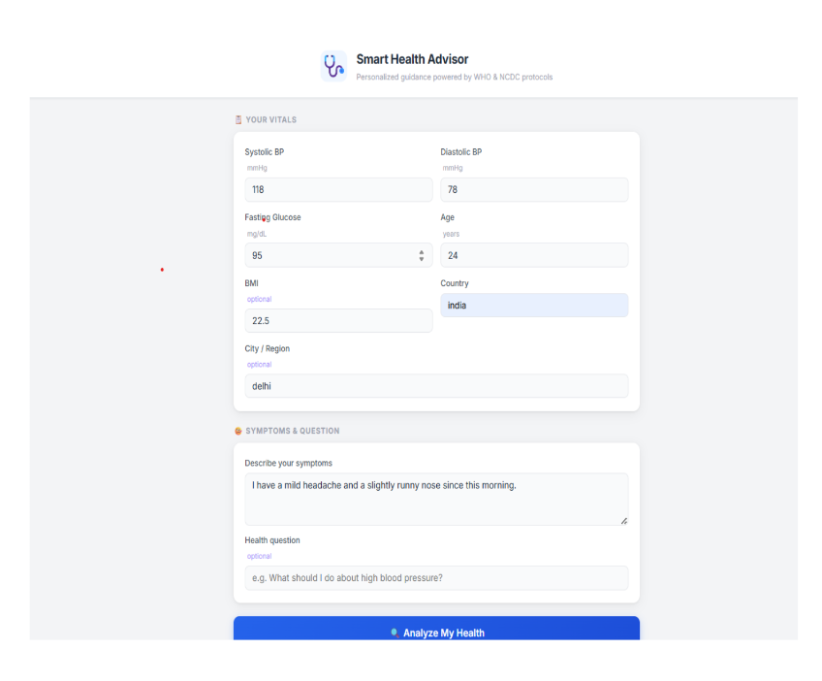
FIG. 3 – USER INTERFACE FEATURES

Slide 9
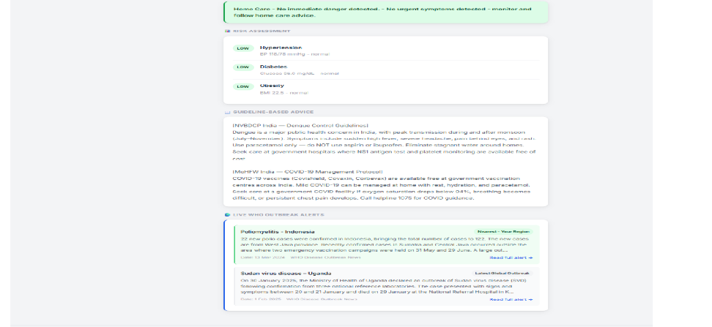
FIG. 4 - RESPONSE INTERFACE

Slide 10
MAJOR FINDINGS
High Prediction Accuracy: The model achieved over 93% accuracy in identifying chronic health risks.
Fast Response Time: Dual-engine processing delivered results in under 1 second.
Improved Clinical Retrieval: The RAG-based system outperformed traditional keyword-based search methods in clinical relevance.
Effective Edge-Case Detection: Accurately distinguishes mild cases for home care while rapidly identifying severe health conditions.
Reliable and Scalable Performance: Demonstrated efficient healthcare support with consistent decision-making.

Slide 11
FUTURE IOMT READINESS
Wearable Integration: Architecture is pre-configured to ingest continuous data streams from Bluetooth-enabled blood pressure cuffs and glucometers.
Scalability: Ready to be containerized (Docker/Kubernetes) to serve larger populations.
Federated Learning: Potential to implement privacy-preserving personalization without requiring massive cloud data transfers.

Slide 12
CONCLUSION
-Bridges the gap between AI-driven health diagnostics and formal medical communication.
-Reduces misinformation by aligning AI guidance with trusted regulatory standards.
-Enables underserved and remote communities to make informed healthcare decisions.
-Demonstrates that impactful AI healthcare solutions can operate without extensive hardware infrastructure.
-Highlights the potential of accessible, intelligent, and scalable healthcare technology.

Slide 13
TECH STACK & REFERENCES
Tech Stack: Python, Node.js, React,
FastAPI, LangChain, Sentence-Transformers, MongoDB.
References:
World Health Organization (WHO) & NCDC Protocols.
J. Bajwa et al., "Artificial intelligence in healthcare," NPJ Digital Medicine.
S. Sahoo, "IoMT empowered smart healthcare models."

Slide 14
Thank You
14

